Slide 1
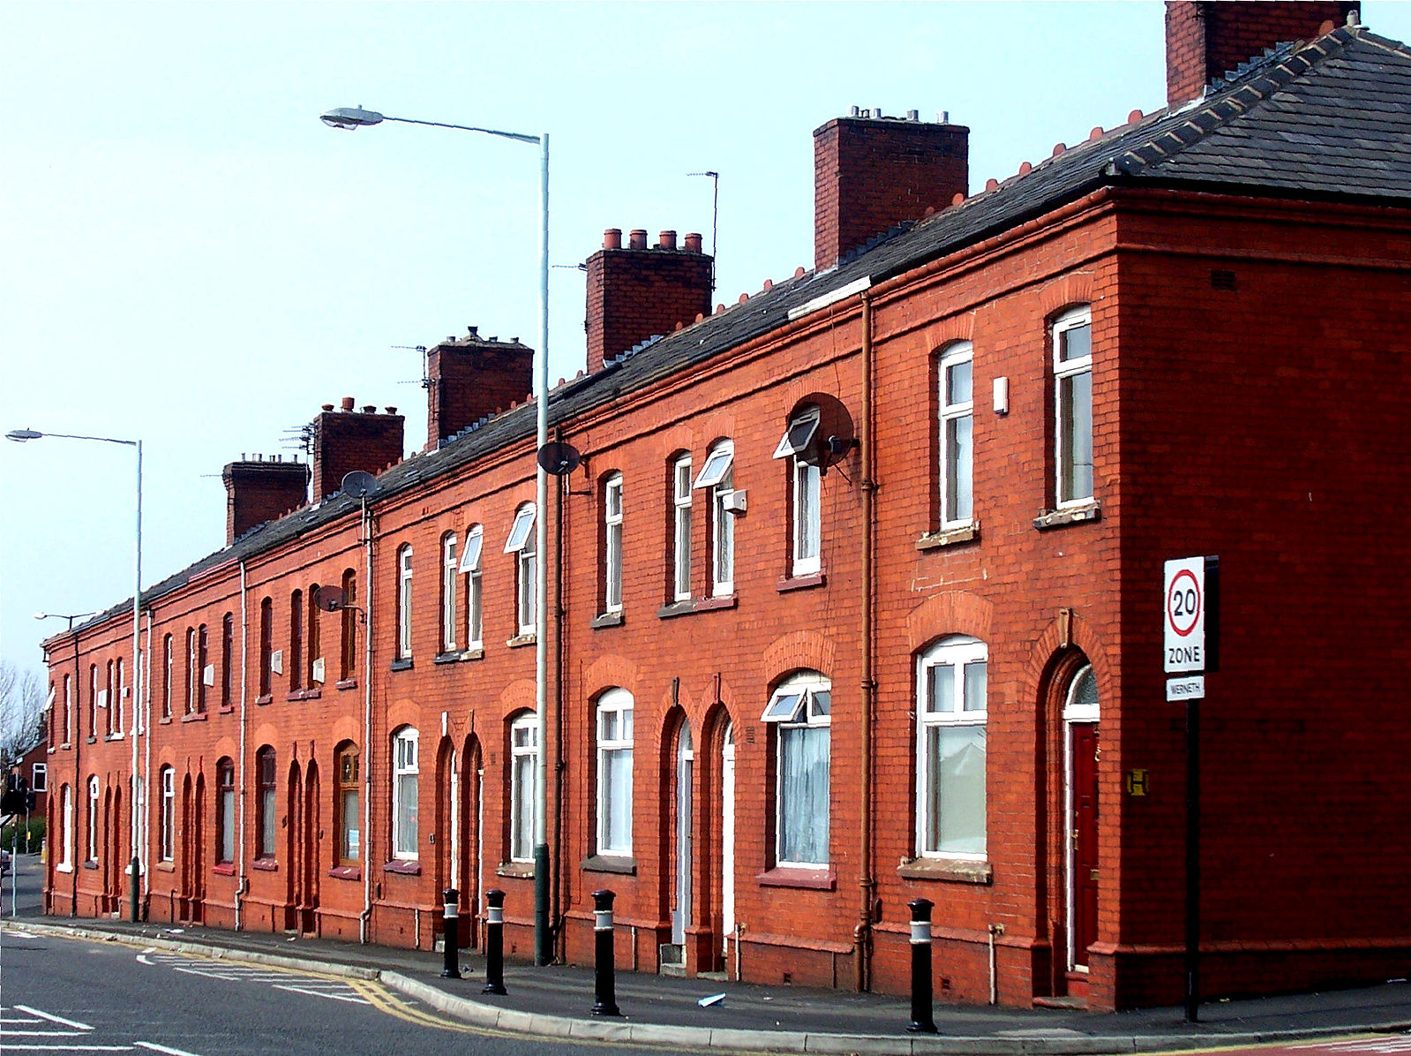
The money to buy new iPhone11 represents just over a sixth of a Grantham first-time buyers mortgage deposit…
Could this be one of the reasons why younger generation aren’t buying?

